Slide 1



6. Blockchain Payment Channels: Economic Impact
Melanie Swan
Philosophy, Purdue University
melanie@BlockchainStudies.org
Slides: http://slideshare.net/LaBlogga

Slide 2







Melanie Swan, Technology Theorist
Philosophy and Economic Theory, Purdue University, Indiana, USA
Founder, Institute for Blockchain Studies
Singularity University Instructor; Institute for Ethics and Emerging Technology Affiliate Scholar; EDGE Essayist; FQXi Advisor
Economics and Financial Theory Leadership
Traditional Markets Background
New Economies research group
https://www.facebook.com/groups/NewEconomies
Source: http://www.melanieswan.com, http://blockchainstudies.org/NSNE.pdf, http://blockchainstudies.org/Metaphilosophy_CFP.pdf

Slide 3
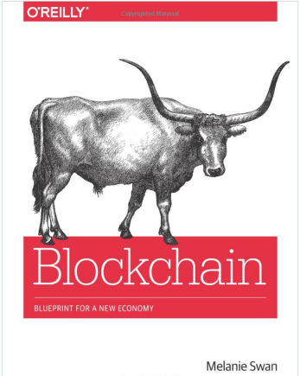

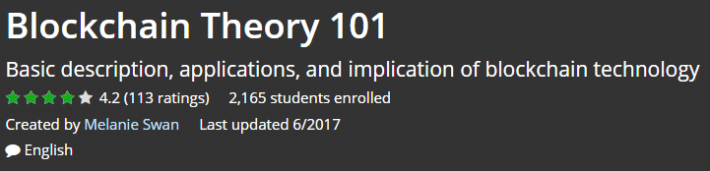

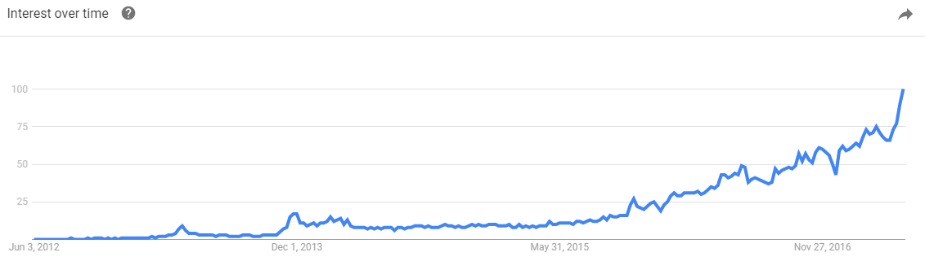
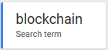
Blockchain
To inspire us to build this world
Source: http://www.amazon.com/Bitcoin-Blueprint-New-World-Currency/dp/1491920491

Slide 4


Mindset of Innovation What is the Killer App of Blockchain?
Netscape makes the web browsable (1995)
Google makes the web searchable (1999)
? makes the blockchain indispensable (2xxx)
???

Slide 5


Stanford, Nov 4-5, 2017
Cancun, Nov 1-4, 2017
Privacy: confidential transactions (zk proofs+)
“Bulletproofs” efficient range proofs (efficient: proof size is logarithmic in the witness size; range: x-y) (Bunz)
Payment channel SLAs, guarantees
Multiple simultaneous transactions
Multiple simultaneous channels
Scalability
FlyClient (thin-SPV client (most recent not full list of header hashes)), BlockSci (agnostic chain explorer platform), Graphene (IBFT block propagation)
Cryptography
EC-DSA, Schnorr signatures, quantum cryptography
Smart contracts, payment channels for Ethereum
Source: http://web.stanford.edu/~buenz/pubs/bulletproofs.pdf

Slide 6

Agenda
Market Update
Payment Channels

Slide 7
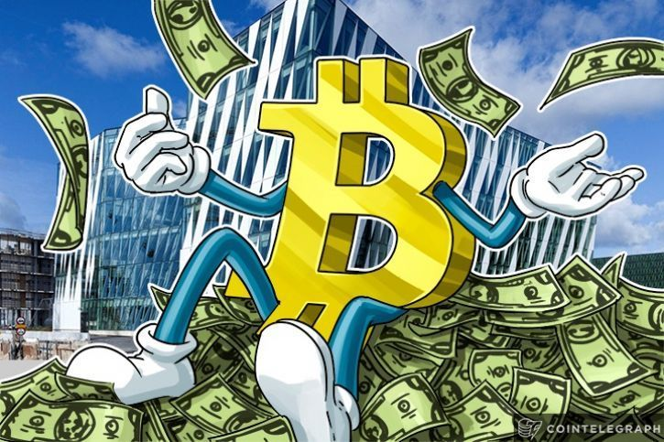
Blockchain Investing
Source: https://cointelegraph.com/news/why-bitcoin-continues-to-be-on-the-top-of-its-game

Slide 8
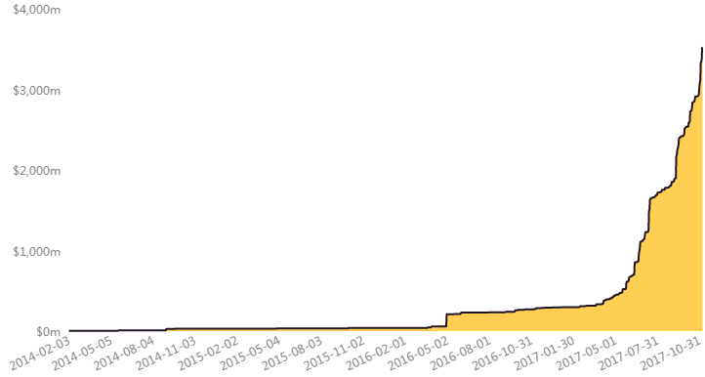


ICOs = “crypto-daytrading”?
$3.5 bn cumulative ICO funding (Coindesk)
ICOs surpass VC funding (PitchBook)
ICOs: $3.5 bn, VC funding: $2.7 bn (2/14-10/17)
Tokens: many functions beyond fundraising
Voting, dividends, access, participation, notification
Cumulative ICO Funding
2/3/14 - 10/31/17
Source: https://www.coindesk.com/ico-tracker, https://pitchbook.com/news/reports/3q-2017-fintech-analyst-note-blockchain

Slide 9

ICO Regulatory Stance
US: investor protection; regulated (Jul 2017)
ICOs and exchanges; what about smart contracts?
ICOs vs token sales (network utility) vs crowdfunding
Howey Test: is it a security?
Investment of money
Expectation of profits from the investment
The investment of money is in a common enterprise
Any profit comes from the efforts of a promoter or third party
International Climate
UK: caveat emptor; safer if regulated, not regulated
China: banned, exchanges ordered to close (Sep 2017)
Russia: regulation expected by end 2017 (Sep 2017)
Reg Arb: Gibraltar DLT Regulated Entities (2018e)
Source: https://www.coindesk.com/ico-tracker, https://www.coindesk.com/china-outlaws-icos-financial-regulators-order-halt-token-trading/

Slide 10
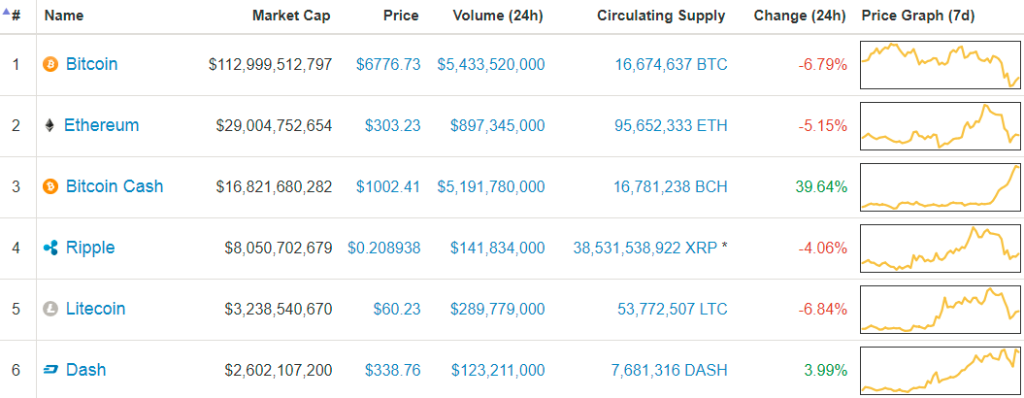
Cryptocurrency Market Capitalizations (11/17)
S&P 500: $22.2 tn; US GDP $18.8 tn
Crypto market cap: $200 bn (≃ top 50th of 200 countries)
Source: https://coinmarketcap.com, http://us.spindices.com/indices/equity/sp-500; List of countries by GDP (nominal) - Wikipedia

Slide 11
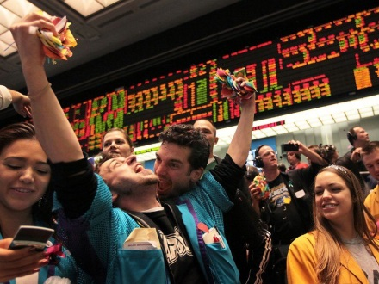

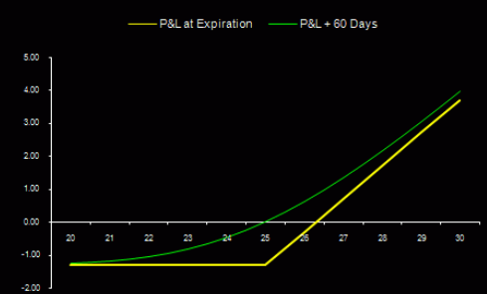

Regulated Futures & Options
1. LedgerX Options
Cleared $1m (week 1), $2m (week 2)
NY-based CFTC-regulated Swap Execution Facility (SEF) and Derivatives Clearing Organization (DCO)
Swap execution facility, clearing Bitcoin options
Sep 2017 began providing physically-settled put and call options and day-ahead swaps trading
Private trading for large customers
Source: https://www.bloomberg.com/news/articles/2017-07-24/bitcoin-options-to-become-available-in-fall-after-cftc-approval

Slide 12
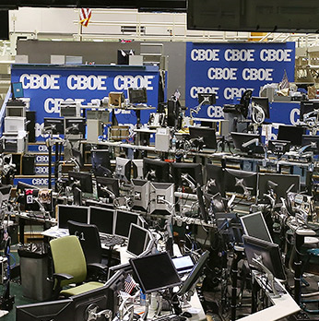
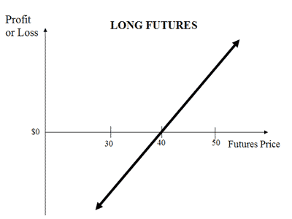
Regulated Futures & Options
2. CME Bitcoin futures contracts – 4Q17e
Cash-settled
Settlement based on CME CF Bitcoin Reference Rate (BRR), launched in November 2016 with London-based Crypto Facilities trading platform
3. CBOE Bitcoin futures contracts - 1Q18e
Cash-settled, pending CFTC review
Settlement based on Gemini Trust data
Significance: cryptocurrency exposure in an institutional product, demand could be huge
Source: https://www.cnbc.com/2017/10/31/cme-plans-to-launch-bitcoin-futures-by-year-end.html

Slide 13

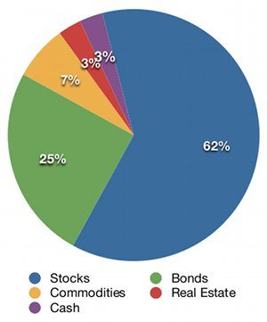
Institutional Markets
Exposure to cryptographic assets
Asset class current value: $200 billion
Estimated value in 10 years: $2 trillion
Demand for regulated products
Dark pools (institutional exchanges for Contracts-for-Difference, private trading, block trades; $20m+)
Genesis Trading, Cumberland Mining, Circle, Gemini Exchange, Project Omni
Regulated Futures and Options
LedgerX, CME, CBOE
Regulated ICOs
Source: https://bitcoinmagazine.com/articles/op-ed-blockchain-economy-ushering-new-world-economic-order, https://www.coindesk.com/standpoint-founder-bitcoin-asset-class-will-grow-2-trillion-market/

Slide 14
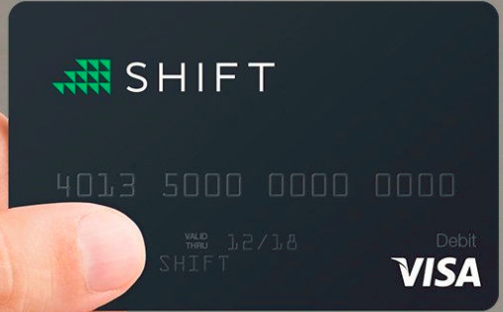
Private Chains: zk proofs
Monero
Z-Cash
Dash
Aeon
Pivx
Kimodo
Live connection to Coinbase (1% fee)

Slide 15
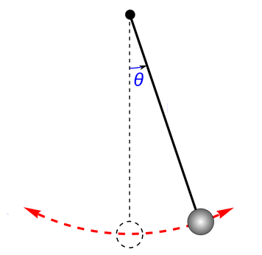
Privacy Pendulum: Swinging back to more privacy
Historically: lots of privacy; Surveillance era: strange logic of few bad apples so insecure surveillance of all; centralized (Equifax) cybersecurity does not work
Future era: swing back to privacy; restore checks & balances
More Privacy
Self-determined Reality
Institutionally-specified Reality

Slide 16



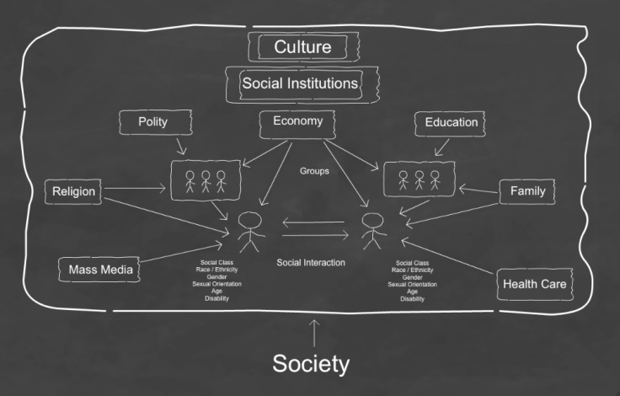
Social Theory of Blockchain Bigger stakes: Societal Structure
Privacy is merely the first battle
Internet failed to include privacy
Tension
100 years
Societal Structure
Privacy
Impact

Slide 17


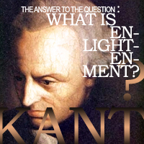
Crypto-enlightenment
Economics and Government
“Multiple private currencies should compete for customer business”
- Friedrich Hayek
“One ought to think autonomously, free of the dictates of external authority” - Immanuel Kant
Source: Kant, I. "Answering the Question: What Is Enlightenment?" (German: Beantwortung der Frage: Was ist Aufklärung?). 1784. Hayek, F. The De Nationalization of Money. 1976. (paraphrased)

Slide 18
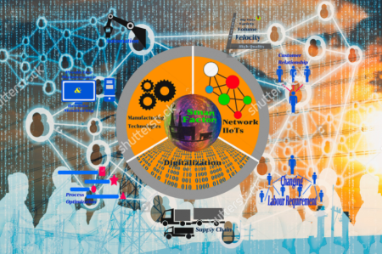

Agenda
Market Update
Payment Channels
Blockchain Economics & Finance

Slide 19

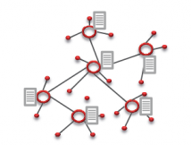
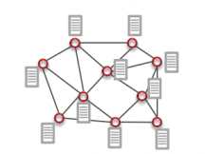
Distributed Networks
Radical implication: every node is a peer who can provide services to other peers
Centralized
Decentralized (based on hubs)
Distributed
(based on peers)
Source: http://www.amazon.com/Bitcoin-Blueprint-New-World-Currency/dp/1491920491

Slide 20
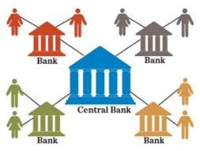
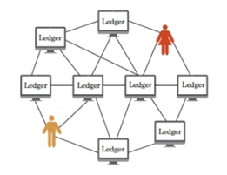
P2P Network Nodes provide services
Nodes deliver services to others, for a small fee
Transaction ledger hosting (~10,000 Bitcoind nodes)
Transaction confirmation and logging (mining)
News services (“decentralized Reddit”: Steemit, Yours)
Banking services (payment channels (netting offsets))
“Classic” Banking
Peer Banking
Centralized bank tracks payments between clients
Network nodes store transaction record settled by many individuals
Source: http://www.amazon.com/Bitcoin-Blueprint-New-World-Currency/dp/1491920491

Slide 21
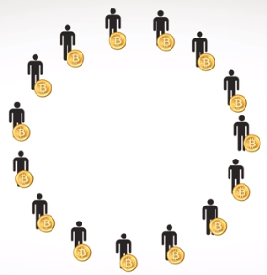
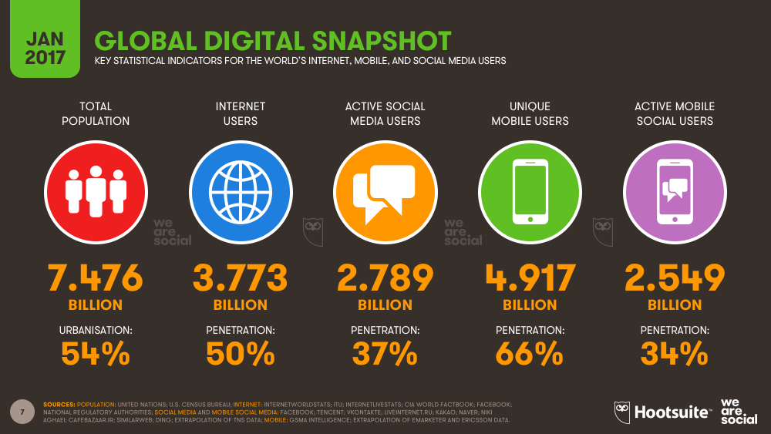
4.9 bn global mobile users (65% world)
Era of digital services
Computationally-based society has less need for a brick-and-mortar institutional footprint
Are we ready? Is a bloom filter a worse version of a FICO score (e.g. a black box determining my life over which I have no say)?
Source: https://wearesocial-net.s3.amazonaws.com/uk/wp-content/uploads/sites/2/2017/01/Slide007.png

Slide 22



Bottom-up Finance: La Plataforma
Source: http://www.laplataformalatam.com/#nosotros

Slide 23
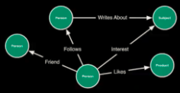
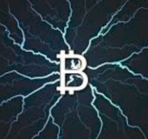
Payment Channels: the concept
Network is a graph (vertices, edges)
Payment, credit, transaction graph
Net clearing
Contracts-for-difference (CFD); (without the 10x options-style leverage of the financial instrument)
Spread betting
Net settlement (vs Gross settlement)
Central banks clear amongst themselves with RTGS (real-time gross settlement) systems (as does Ripple)
Industry consortia, interbank daily settlements are tabulated on a net basis
3. “Have an account,” “run-a-tab” economy

Slide 24
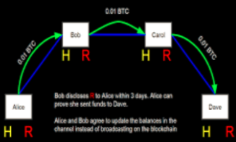
What is a Payment Channel?
3-step financial contract executed over time
One party opens a payment channel with another party and posts a pre-payment escrow balance
The party consumes against this credit over the given time period (activity is tracked)
At the end of the period, cumulative activity is booked in one net transaction to close the contract
Source: https://www.psmarketresearch.com/market-analysis/personal-robot-market

Slide 25

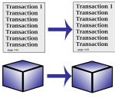
What is a Payment Channel?
Motivation
Improve scalability through contractually-obligated relationships booked as periodic net activity
Micropayments mechanism for video bandwidth consumption where piecemeal transactions do not make sense
Current ~$250 max (4% Btc) for Lightning Payment channels
Bigger implication
Might develop into a digitized payment system for resource consumption that settles based on net payments instead of gross transfers, and enables peer-to-peer banking services
Sophisticated functionality
Concatenated payment channels, time/signature lock parameters (CheckLockTimeVerify, CheckSequenceVerify)
Source: https://www.psmarketresearch.com/market-analysis/personal-robot-market

Slide 26

Payment Channels: Level 1
Starbucks Example
Customer opens $50 monthly payment channel with Starbucks
Daily coffee consumed is tracked and booked against the $50 credit
Activity is netted at the end of the month. Contracts close and roll over at regular intervals. Either party may close the channel early, trigger net settlement
SBUX: payment channel prototype
Loyalty program (cards & apps): 41% purchases, $1.2 bn obligations
SBUX Balance Sheet
Assets
Cash $1.2bn
Liabilities
Stored Value Cards $1.2bn
Source: https://www.psmarketresearch.com/market-analysis/personal-robot-market

Slide 27

Accounting and Legal Treatment?
Promise of cryptocurrencies as “programmable money” in implementation
A contingent three-part financial contract over time is a new instrument
Financial contract feature sets:
Prepayment risk
European/American-style option execution
Fractional reserves
Accounting: deferred payment, installment sale? Revenue recognition, liability?
Loan: each peer node (LN) registers a loan
Legal: assignments of claims, forward-looking IOUs?
Source: https://www.psmarketresearch.com/market-analysis/personal-robot-market

Slide 28
Payment Channels: Level 2
Small group concatenated payments example
Local bar: Lynn, Chris, Bartender
Lynn has a $10 tab with bartender, has consumed $6
Chris has a $10 tab with bartender, has consumed $5
Lynn and Chris play pool, Chris owes Lynn $5
Current method (gross settlement): each party settles with each other (3 tx, $16 gross flow)
New method (net settlement): (2 tx, $11 gross flow)
Already see implication if less money transfers, more is available
Bartender
Lynn
Chris
Current Method
Payment Channel
A/R
A/R
A/P
A/P
Lynn $6
Chris $5
Bar $6
Bar $5
Chris $5
Lynn $5
Tx1 $6-Lynn
Tx2 $5-Chris
Tx3 $5-Lynn
Tx1 $10 C-to-B
Tx2 $1 L-to-B
$11
$1
$10
Source: Andreas Antonopoulos

Slide 29
Payment Channels: Level 3
My monthly expenses example
De facto payment channel
Inflows into bank account:
Paycheck direct deposit
Outflows from bank account:
Auto-pay bills (fixed and variable)
Formalized into a multi-party payment contract netting salary against expenses, any remainder to Schwab investment account
Implication: settling net basis frees capital
Consider business entities on a net basis
My monthly expenses
DR
CR
Salary (direct deposit)
$xx
Expenses (auto-pay)
Rent (fixed amount)
Car payment (fixed)
Utilities (variable)
$xx
$xx
$xx
$xx
Discretionary (variable)
$xx
Net savings (variable)
$xx
My apartment building
DR
CR
Expected inflows
$xx
Expected outflows
Fixed
Variable
Net
$xx
$xx
$xx
My small business
DR
CR
Expected inflows
$xx
Expected outflows
Fixed
Variable
Net
$xx
$xx
$xx
Source: https://www.psmarketresearch.com/market-analysis/personal-robot-market

Slide 30
My supply chain: payment graph economy
Blockchains: only sub-registers of the cash account (Alice, Bob, HSBC, etc.), not a full suite of general ledger accounts
Property registries use cash-acct ledger structure
Property registries where UTXOs are assets
Birth/death registry: one credit tx, one debit tx
Supply chain finance: for supply chain net settling, need integrated account ledgers
Single set of books with multiple views: by supply chain (new) + by entity (existing)
Revenue (WMT); COGS (Deere, Adidas)
Cash
DR
CR
Alice
$xx
Bob
$xx
HSBC
$xx
Carol
$xx
Ralph
$xx
My supply chain
Goods trajectory
Orthogonal trajectories, different incentives, behavior
Payments trajectory
Sales
Inventory
COGS
Manufacturing
Raw Materials
Source: https://www.psmarketresearch.com/market-analysis/personal-robot-market

Slide 31
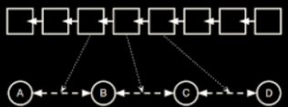
Payment Channels: Level 4
“Kevin Bacon” example
5 hops to transfer funds?
Large-scale multi-hop payment graph
Scalability of 1:1 payment channels?
Do users really want to be peer hosts?
Single-escrow commits (deposit > use)
Confirmation, timing, max flow, fees
Either
Every node is a peer banker
Wallet is permissioned to clear transactions
Lightning network hubs or payment gateways
Source: https://www.psmarketresearch.com/market-analysis/personal-robot-market

Slide 32
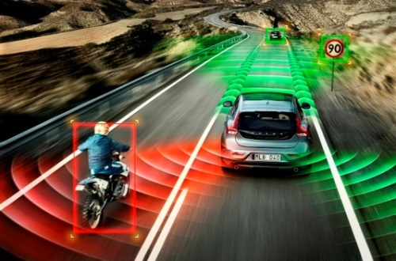
Payment Channels: Level 5
“Mike Hearn” example
Farther-future possibility of auto-instantiating self-driving cars and other smart network resources
Smart network instantiates banking services directly (sensing network demand, auto-instantiates, provides services, retires when necessary)
Network node does not need to be human-backed (technically)
Historically-vested grounding of roles, responsibilities, taxation in legal personhood
Source: https://www.psmarketresearch.com/market-analysis/personal-robot-market

Slide 33

Implications
With money and payments digitized, and activity being securely forward-committed by payment contracts, the implication is that net flows instead of gross flows might be transferred
An economy based on net clearings rather than gross transfers could mean more activity and less debt
Rethink Debt
Streaming money (Antonopoulos) could be disgorged in much smaller chunks that are more closely tied to costs and repayment possibilities
Challenge: how to construct net rather than gross obligations for home mortgage, student loan, public works projects, bond offerings?
Source: https://www.psmarketresearch.com/market-analysis/personal-robot-market

Slide 34

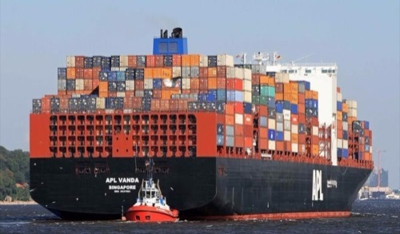
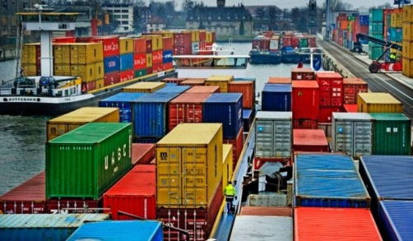
Modes of consumption: pre-pay vs post-pay
Rethink modes of consumption: pre-pay vs post-pay
Pre-paid consumption (a small part of current overall economic activity) against the much larger portion of activity that is post-paid and based on credit and terms
Two-thirds of the economy tied up in supply chain finance
Incentive is to play the float; instead, incentive to net out
Digitized streaming money and payment channels could be techniques to quicken the 30-60-90 day terms and uncollectible debt problem in supply chain finance, and facilitate a just-in-time economy for money
Source: https://www.psmarketresearch.com/market-analysis/personal-robot-market

Slide 35
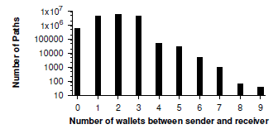
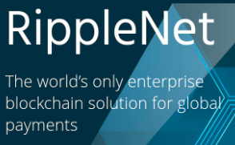
Existing payment graph Ripple Credit Network
Highly-interoperable transactions
Cross-border fiat remittance
Cryptocurrency exchange
User-defined currencies
Integrated payment methods: Alipay, Paypal, Bitcoin, USD
Extensive wallet functionality
Access cash
Access credit
Issue credit
Operating 5 years (Data for 1/13-12/16)
99,413 wallets; 246,672 credit links; 27,406,877 tx
12/50 world top banks, open network, consensus via validators (55); transaction blocks each 4 seconds
Credit ripples across network links (path-routing like Internet packets)
Avg 1-3 wallets betw send-rcv
Source: Moreno-Sanchez et al., 2016, 2017

Slide 36

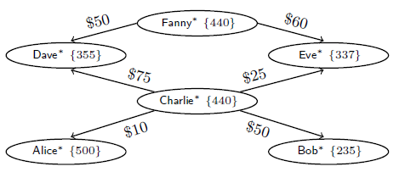
Ripple Credit Network
Weighted directed payment graph of IOU credit links
Credit graph
Vertices: wallets (wallet balances; 1, 2)
Edges: credit links (between 1,2; 2,3)
W₂
E_{1,2}
E_{2,3}
W₁
E_{3,1}
W₃
Transaction ripples through network
“Payment” = payment or credit extension
Example: Dave pays $50 to Eve
$0
$110
{305}
Concept: open credit links between parties in game-theoretic network
Source: Moreno-Sanchez et al., 2016, 2017

Slide 37
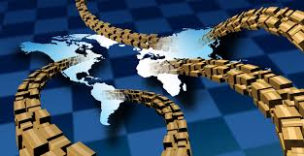
“Ripple for ERP”
Integrated supply chain ledgers
Open permissioned links in corporate accounting software for trade partners to post to each other’s ledgers
Impact: allow net-clearing of accounts, thereby reducing supply chain debt up to 95%
Supply chain finance
$3.9 tn working capital tied up in global supply chains
$1.5 tn global trade finance gap (trade finance transactions rejected by banks but needed for global distribution)
Blockchain cloud services & big 4 accounting
IBM, Microsoft, Oracle, SAP; PWC, Deloitte, E&Y, KPMG
Hosted full suite of cross-ledger account-level posting
Source: Swan, M. in review, European Financial Review

Slide 38

Payment graphs Next step in Automatic Markets progression
Existing
High-frequency trading (HFT) / algorithmic trading
Real-time bidding (RTB) markets for advertising
Global energy trading
Production, storage, and transmission
Distributed energy management systems
Next
Banking and finance
Ripple: 27 million transactions (1/13-12/16)
DFINITY: automated commercial loan approval
Facebook payments: social graph becomes payment graph
Source: https://www.psmarketresearch.com/market-analysis/personal-robot-market

Slide 39
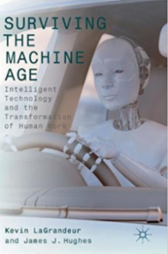



Conclusion
Use these concepts and tools to solve a larger class of economic problems like debt
Economic incentive counter to outcome
Supply chain: play the float
Maximization not price rationalization in health care
Entitlements (payment channel for social security?)
Income inequality, digital divide
Automation economy, technological unemployment
Have to own investment assets
Saas (securities as a service): access to consumable benefits of an asset without having to own the underlying (Spotify, Hulu, Uber, Airbnb)
Source: https://www.psmarketresearch.com/market-analysis/personal-robot-market

Slide 40
Agenda
Resources

Slide 41


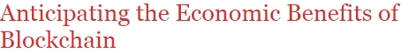
Recent Publications
Blockchain Philosophy
Blockchain Economics
Themes (ontological, epistemological, axiological)
Mathematical models for understanding reality
Challenges naming and orchestrating virtual world naming entities and their physical analogs
Sociopolitical institutions such as money and property
Moral obligations of software developers
Source: http://timreview.ca/article/1109

Slide 42
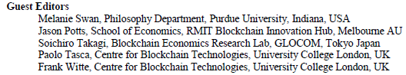

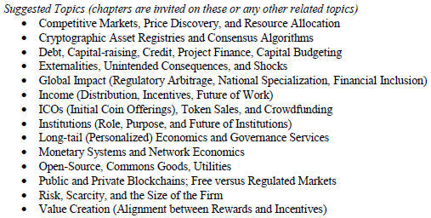
Blockchain Economics Book chapter CFP
4,000 words chapters due Mar 1, 2018 to m@melanieswan.com
Publisher
Source: http://blockchainstudies.org/CFP_Blockchain_Economics.pdf

Slide 43



Blockchain DLT Standards bodies: Ledgers on distributed computing networks
FASB: Emerging Issues Task Force (BC GAAP)
IETF: Distributed Networking IRTF.org
Payment Standards
W3C Web Payment Interest Group
International Payments Framework Assn
Center for Financial Services Innovation Network
IC3: Initiative for Cryptocurrencies and Contracts
IBM Blockchain Technology – Hyperledger
Microsoft Blockchain Technology – Azure BaaS
Amazon AWS Blockchain Technology – Dig Curr Gp
R3 Corda Blockchain Technology
Source: https://www.psmarketresearch.com/market-analysis/personal-robot-market

Slide 44
6. Blockchain Payment Channels: Economic Impact
Melanie Swan
Philosophy, Purdue University
melanie@BlockchainStudies.org
Slides: http://slideshare.net/LaBlogga

Slide 45
Agenda
Practical Opportunities

Slide 46



Blockchain Strategies Opportunity: Low-hanging Fruit
Information confirmation, not monetary transfer:
Cryptographic asset registries
Investor information services
Supply chain, logistics
CRM, Business Logic
Energy quoting, transmission
Automate administrative steps
Stock Transaction
Steps with human decision-making
Real Estate Purchase/Sale
Health Insurance Billing
Energy Contract
Steps that can be automated with blockchain
Supply Chain Shipment

Slide 47


Blockchain Strategies Opportunity: Cryptographic Registries
Asset Registries
Land, auto, home titles
Stocks, bonds, insurance
Sales quotes, RFP
Public Documents
Driver’s license, permit
Business registration
Regulatory & QA compliance
Diploma, credential
Passport, identity document
Voter registration, census
Birth and death certificates
Illinois, Arizona, Delaware, Idaho
Finland, Dubai, Georgia, Estonia, Sweden, Denmark

Slide 48

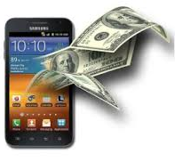

Blockchain Strategies Opportunity: Leadership Edge
Start or join industry consortium
Implement digital ledgers
Automate transfer of money, assets, bids, quotes, RFPs, ERP, supply chain
Value chain process mapping
Revenue-generating
Offer blockchain-based services to clients
Example: banks targeting larger customer base through blockchain-based eWallet solutions
Cost-saving
Finance, treasury, accounting, GL/AR/AP
Quality assurance, regulation, compliance, audit functions
Source: http://www.amazon.com/Bitcoin-Blueprint-New-World-Currency/dp/1491920491

Slide 49
Agenda
Blockchain Economic Theory

Slide 50




What is Economics?
Study of the production, distribution, and consumption of goods and services
Individual and group decision-making about goods and services and the consequences
Fundamental dynamics do not change
Wants are bigger than resources, cost of decision-making, opportunity cost, scarcity (material or intangible)
Same in all forms of economies
Classical Economics (material goods)
Network Economics (digital goods)
Smart Network Economics (automated smart contracts exchanging cryptographic assets)
Source: http://blockchainstudies.org/Blockchain_Economics_CFP.pdf

Slide 51


Economics: Basic Design Principles
Economic Principles
Traditional Deployment
Markets
Blockchain Deployment
Any interaction is a discovery and exchange process
Abundance mindset and overcoming scarcity
Decentralized models supplement hierarchy
Demurrage incitatory potential and resource redistribution across network nodes
Reciprocal mining communities
Blockchain technology is prompting us to rethink economic principles in markets, and apply them much more extensibly to other situations in a non-monetary sense

Slide 52
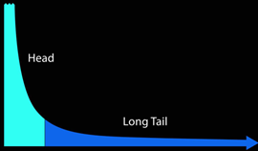

Reinventing Economics and Government
Long Tail premise
80/20 rule false in digital markets
Sell less quantity of more items
Look at the long tail as a market itself
Long Tail Effect
Analysis (Brynjolfsson et al., 2006, 2010)
Amazon: niche books account for 36.7% of sales
Power laws not Pareto distributions in etailing (books, music), software downloads (70/30 not 80/20)
Critique (Elberse, 2008)
Pareto distribution not power laws in some markets
Evolving market: feedback effect of online reviews
Key point: personal preference markets work
2006
Source: Anderson; Brynjolfsson; Elberse

Slide 53



Long Tail Financial & Government Services
One size does not fit all
Any two parties can meet and transact on a blockchain
Long Tail Systems
One size fits all
Personalized
Rethink debt with small-chunk capital
Long Tail financial services
“Amazon or eBay of money”
Personalized banking, credit, mortgages, securities
Long Tail governance services
“Amazon or eBay of government”
Personalized governance services, pay for consumption
Source: http://www.amazon.com/Bitcoin-Blueprint-New-World-Currency/dp/1491920491

Slide 54
Economics and Finance
Systems for organizing access to resources
Economics
Past, Present
Finance
Future
Time
Cryptocurrencies: Spot Market
Smart Contracts: Futures & Options Market

Slide 55

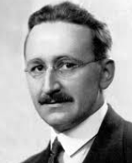
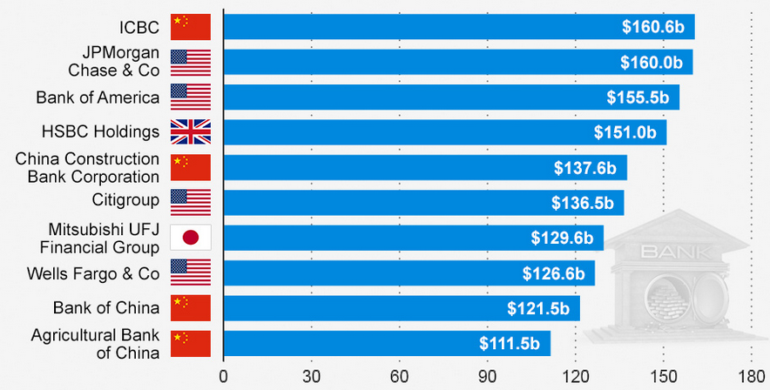
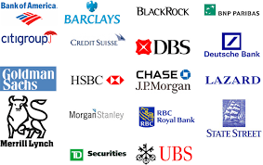

Hayek: Financial Institution Currencies
“Multiple private currencies should compete for customer business”
- Friedrich Hayek
Top Global Banks based on Tier 1 Capital (2014)
Top Investment Banks
Source: Hayek, F. The De Nationalization of Money. 1976. (paraphrased); https://www.statista.com/topics/1552/banks-in-china
Tier 1 Capital: equity capital + disclosed reserves (measure of banking strength)

Slide 56
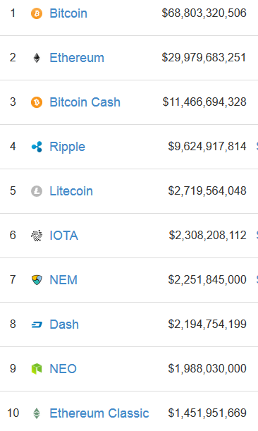
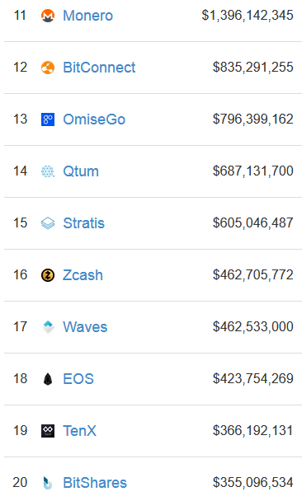
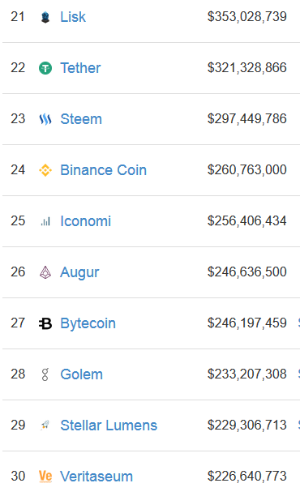
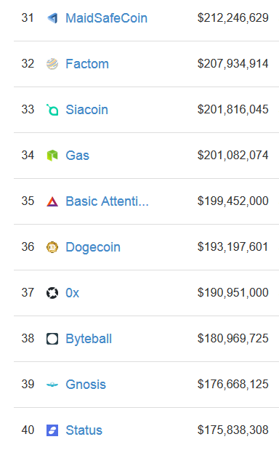
New Economic World Order
Not just cryptofinance, every company own coin issue
Cryptocurrencies and storage, banking, healthcare, financial services, technology platforms, fundraising firms
Source: https://bitcoinmagazine.com/articles/op-ed-blockchain-economy-ushering-new-world-economic-order

Slide 57







Securities as a Service
Asset
CD, DVD
Auto, Home
Securities
Streaming Music and Video Services
Uber, Lyft, Gett, Juno, Via; Airbnb, VRBO HomeAway
Consumable benefits of securities: cash flow, appreciation
Service
Entertainment as a Service
Transportation, Domicile as a Service
Securities as a Service
Securities a Service
Now have to own because uncertain future value of assets
Access to the consumable benefits of the asset without owning
Works if trust consumable assets will have future availability
Need the cash flow the asset provides, not the asset itself
Source: Blockchain Fintech: Programmable Risk and Securities as a Service, http://futurememes.blogspot.com/2016/10/blockchain-fintech-programmable-risk.html

Slide 58








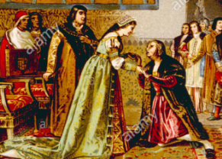






Future of Institutions
Role: organize life and manage contention
Influence persists but more choice about belonging
Historical
Contemporary
Future
Building
Building - Website
Building – Website – Credential
Bank
Government
Police
Church
Crown
Farther Future
DMV
Healthcare
Academia
Data pillars: library of all society’s memory and public records
Columbus’s VCs: Ferdinand and Isabella
Corporation
Church
Law

Slide 59

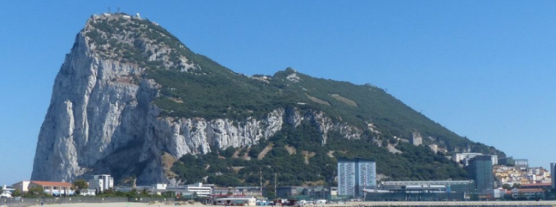


Future of Nation States
Regulatory Arbitrage and Crypto-Specialization
DE-based C corporations
Swiss & Cayman banking laws
Estonia eResidency Program
Gibraltar DLT Registered Entities (ICO response)
Malta online casinos & Bitcoin
Transnational boundaries
ICANN & decentralized DNS/ENS
Namecoin (.bit domains)
Ether (.eth domains)
Human Rights, Refugees

Slide 60

Blockchain Economic Theory
Production, distribution, and consumption of goods and services in a Blockchain Economy…
Same as a Classical Economy
Underlying dynamics do not change: wants outweigh resources, cost to decisions, scarcity of valued resources
Institutions, Money, Nation States persist, change in form
Assets, identity, & information now become cryptographic
Different than a Classical Economy
Hybrid economy of human and computational agents
Leapfrog technology: financial inclusion and rethink debt
New economic design principles: long tail, decentralization, assets as a service, smart contracts
Source: http://blockchainstudies.org/Blockchain_Economics_CFP.pdf

Slide 61




Blockchain Economic Theory
Elements of Economic Theory |  | Not Changing | Changing
Basic Definition
 | Production, distribution, consumption of goods and services | X
 | Individual and group decision-making and consequences | X
 | Wants exceed resources, opportunity cost, scarcity | X
 | Shift: material goods to intangible goods and services |  | X
Employment
 | Technological Unemployment (Automation Economy) |  | X
 | Multi-Agent Economy (Computational Agents) |  | X
Institutions and Nation States
 | Role and Influence | X
 | Form and Choice about Joining |  | X
Money, Capital, and Debt
 | Importance and Role | X
 | Form and Access |  | X
Principles
 | Long Tail Markets (Personalized Services) |  | X
 | Decentralization/Financial Inclusion |  | X
 | Drivers: Regulation and Technology Adoption | X
 | Time Frame Focus: Present to Future |  | X
Source: http://blockchainstudies.org/Blockchain_Economics_CFP.pdf

Slide 62
Agenda
Conclusion

Slide 63

Conclusion
Blockchain is a fundamental information technology for secure value transfer over networks
Internet of value; ledger running on a distributed computing network
Institutional investor demand for cryptographic asset class regulated products
Payment channels: an automated contractual arrangement can support aggregate consumption
Deep learning chains: new form of automated global infrastructure, smart network
Identify (deep learning)
Validate, confirm, and route transactions (blockchain)

